Slide 1
SSAS With ADF and Power-BI
BY
Sridhar Shankar

Slide 2
Introduction To SSAS
Analysis Services is an analytical data engine used in decision support and business analytics. It provides enterprise-grade semantic data models for business reports and client applications such as Power BI, Excel, Reporting Services reports, and other data visualization tools.
Azure Analysis Services is a fully managed platform as a service (PaaS) that provides enterprise-grade data models in the cloud.
Azure Analysis Services is available in Developer, Basic, and Standard tiers. Within each tier, plan costs vary according to processing power, QPUs, and memory size.
Multidimensional models and PowerPivot for SharePoint are not supported in Azure Analysis Services.
Azure Analysis Services supports tabular models at the 1200 and higher compatibility levels. Tabular models are relational modeling constructs (model, tables, columns), articulated in tabular metadata object definitions in Tabular Model Scripting Language (TMSL) and Tabular Object Model (TOM) code.
Tabular models in both in-memory and DirectQuery modes are supported.

Slide 3
Pricing
Azure Analysis Services is available in Developer, Basic, and Standard tiers.
Within each tier, plan costs vary according to processing power, QPUs, and memory size.
Development Tier:
Basic Tier:
Plan | QPUs | Memory (GB)
D1 | 20 | 3
Plan | QPUs | Memory (GB)
B1 | 40 | 10
B2 | 80 | 20

Slide 4
Continue…
Standard tier:
Plan | QPUs | Memory (GB)
S0 | 40 | 10
S1 | 100 | 25
S2 | 200 | 50
S4 | 400 | 100
S8* | 320 | 200
S9* | 640 | 400

Slide 5
Data sources supported
Not all data sources and connectors shown are supported in Azure Analysis Services. The types of data sources you can connect to depend on many factors such as model compatibility level, available data connectors, authentication type, providers, and On-premises data gateway support
Datasource | In-memory | DirectQuery
Azure SQL Database | Yes | Yes
Azure SQL Data Warehouse | Yes | Yes
Azure Blob Storage | Yes | No
Azure Table Storage | Yes | No
Azure Cosmos DB | Yes | No
Azure Data Lake Store | Yes | No
Azure HDInsight HDFS | Yes | No
Azure HDInsight Spark | Yes | No

Slide 6

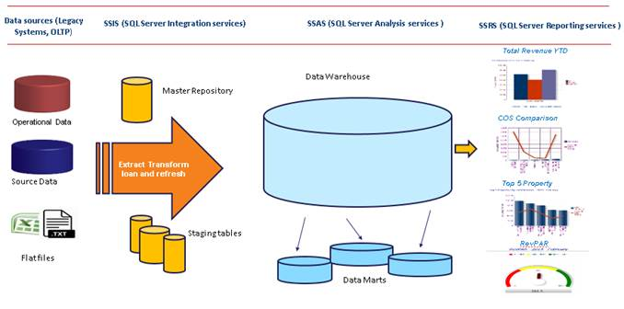
Microsoft BI Architecture
SSIS-Sql Server Integration Services
SSAS-Sql Server Analysis Services
SSRS-Sql Server Reporting Services

Slide 7
Power BI
Power BI is one of the most popular Data Visualization tool, and a Business Intelligence Tool.
Power BI tool is a collection of data connectors, apps, and software services, which are used to get data from a different source, transforms data, and produce beautiful reports.
Access data from hundreds of supported on-premises and cloud-based sources, such as Dynamics 365, Salesforce, Azure SQL DB, Excel, and SharePoint.
Enable business users to dig deeper into data and find patterns they may have otherwise missed, with Power BI features like quick measures, grouping, forecasting, and clustering. Advanced users have full control over their model using powerful DAX formula language.
Power BI Premium supports power bi server hosted on cloud.

Slide 8
ADF
Azure Data Factory is the platform for these kinds of scenarios. It is a cloud-based data integration service that allows you to create data-driven workflows in the cloud that orchestrate and automate data movement and data transformation.
This is how it works.
Without Data Factory, enterprises must build custom data movement components or write custom services to integrate these data sources and processing. It is expensive and hard to integrate and maintain such systems. These systems also often lack the enterprise grade monitoring, alerting, and controls that a fully managed service can offer.
Azure Data Factory is composed of four key components. 1) Pipeline 2) Activity 3) Datasets 4) Linked services
A data factory can have one or more pipelines. A pipeline is a group of activities. Together, the activities in a pipeline perform a task.

Slide 9
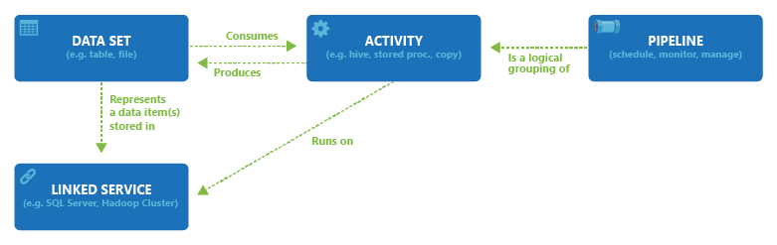
Continue…
A pipeline can have one or more activities. Activities define the actions to perform on your data. Data Factory supports two types of activities: data movement activities and data transformation activities.
An activity takes zero or more datasets as inputs and one or more datasets as outputs. Datasets represent data structures within the data stores. These structures point to or reference the data you want to use in your activities (such as inputs or outputs).
Linked services are much like connection strings, which define the connection information that's needed for Data Factory to connect to external resources.

Slide 10
Create Model
Your Azure Analysis Services server must be at the Standard or Developer tier. New models created by using the Web designer are DirectQuery, supported only by these tiers.
An Azure SQL Database, Azure SQL Data Warehouse, or Power BI Desktop (.pbix) file as a datasource. New models created from Power BI Desktop files support Azure SQL Database and Azure SQL Data Warehouse.
A SQL Server account and password for connecting to Azure SQL Database or Azure SQL Data Warehouse data sources.
You must have server admin privileges to create a new model. Database admin privileges are required to edit and query a model by using the designer.
In Tables and views, select the tables to include in your model, and then click Create. Relationships are created automatically between tables with a key pair
Open the model in Visual Studio (SSDT), Power BI Desktop, or Excel.

Slide 11
References:
For finding information related to pricing and availability please check https://docs.microsoft.com/en-us/azure/analysis-services/analysis-services-overview.
For Power BI related information please check https://www.tutorialgateway.org/power-bi-tutorial/.
For information related to Azure Analysis service please check https://docs.microsoft.com/en-us/azure/analysis-services.
For information's related to Azure Data Factory please check https://docs.microsoft.com/en-us/azure/data-factory/v1/data-factory-scheduling-and-execution
For creating model please refer https://docs.microsoft.com/en-us/azure/analysis-services/analysis-services-create-model-portal

